Slide 1

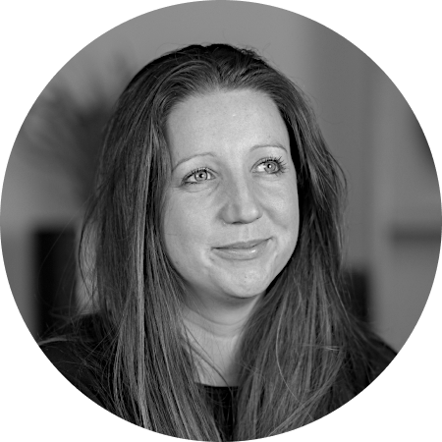

Time to stop living with it
<insert name>
<insert job title>
Notes:
<intro> and before I get started, I would like you to hear from a few other women….

Slide 2



I’m Amara and I only just survived a Heart Attack
“I wish the medical profession had recognised my symptoms sooner and had more tailored treatments available. I was lucky but others on my ward weren’t”
Notes:
Gurveena:
I started having severe chest pains and felt clammy and disoriented. I believed I was having a heart attack, but when the ambulance arrived the paramedic asked me to walk from my car to the ambulance. To me that meant they didn’t think I was having a heart attack and I think they thought I was panicking; of course, I was anxious, but it wasn’t just that.
Initially, the doctors wrongly thought that the blood supply to my heart was only partly blocked, so I wasn’t treated as an emergency. Finally, I was diagnosed as having had the most serious type, where an artery supplying the heart is completely blocked.
But doctors had missed the window to protect my heart from serious damage and I have heart failure as a result of my heart attack.
I felt I’d been badly let down and being a younger woman and slim meant I wasn’t the stereotypical heart attack patient and I think that played a role in how I was treated.
https://www.bhf.org.uk/informationsupport/heart-matters-magazine/my-story/women-and-heart-attacks/carols-story

Slide 3

I’m Jane, 42 years old, and recently diagnosed with ADHD
“I just wish I’d known. It has affected my confidence all my life, my relationships and ability to take opportunities in the workplace”
Notes:
Emma W: I struggled with ADHD as a small child, most memorably when I was taking a test. By the second page, I became bored and uninterested.
As a result, my test results showed that I was borderline retarded. I began to feel stupid because I could not sit down long enough to do the work, and this has deeply impacted my confidence over the years.
My mother refused to test me for ADHD. I did not, however, know that at the time.
Luckily for me, my supervisor is a licensed therapist and suggested I get tested for adult ADD. I explained how I’d gone to a clinic that specialised in treating people with ADHD but the nurse practitioner only gave me antidepressants. My supervisor encouraged me to get re-tested so I could benefit from the right medication.
I got tested for ADHD, was diagnosed and I was prescribed a stimulant. Taking a stimulant made my brain move at a normal pace.
Before medication, I felt I could only use a small portion of my brain. Now I feel that I can use all of my brain. ADHD is a real illness and I have struggled with this illness half my life

Slide 4
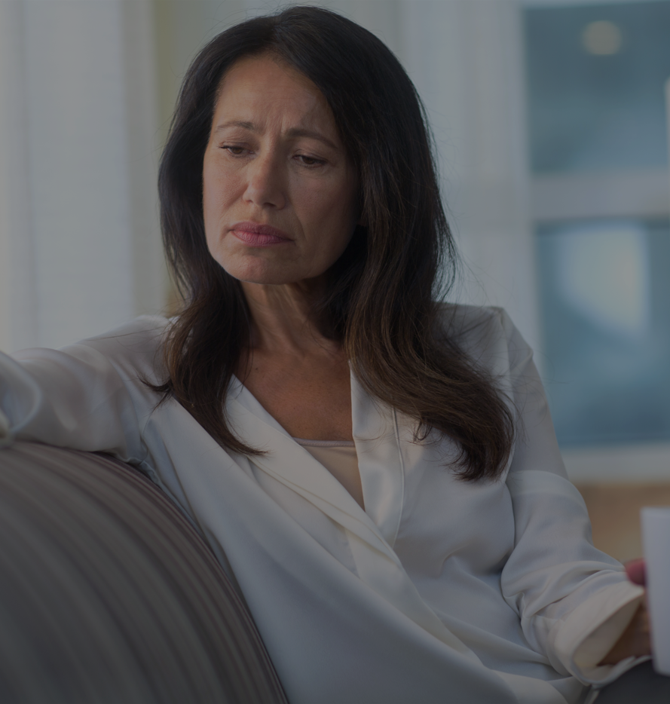
I’m Valentina and I resigned from my job as a Senior Manager due to the menopause
“My memory was shot to pieces. I was taking so many notes in meetings, and I just couldn’t think on my feet anymore. It felt at times that I was barely able to contribute. So, I left the job I loved”
Notes:
Claire:
I was 46 when I went into surgical menopause. I went into my surgery in perimenopause and came out in full blown menopause. It was immediate. Like a ‘bang’.
The symptoms all came at once. I had hot flushes, dry skin and shockingly, my hair started to fall out in clumps. I started to experience an overwhelming sense of panic and anxiety. A feeling of impending doom sat constantly in my chest.
I worked in a senior management position where I led a large team and would spend my days managing my team and talking to people across the organisation, but my memory was shot to pieces. I was taking so many notes in meetings, and I couldn’t just think on my feet anymore and it felt at times that I was barely able to contribute.
So, I made the very difficult decision to leave the job I loved and a career I relished.
I think there is a real need for education and awareness within organisations to ensure no employee feels as isolated as I did.
https://www.wellbeingofwomen.org.uk/campaigns/menopausepledge/stories/overnight-i-felt-id-lost-all-my-confidence-in-my-ability-to-do-my-job

Slide 5

I’m Fatima, it took me years to get diagnosed with endometriosis and there’s little that is known to help me
“The pain comes out of nowhere. I am at work or with friends and suddenly can’t walk and am throwing up from the pain.
Not knowing when it’s coming is the hardest part – I just want someone to know something to help me live a normal life”
Notes:
Natalie
I consider myself to have a high pain threshold. When I first discovered I had fibroids, I just thought that I had painful periods and that was that.
I was still going to work throughout the pain, despite my mum telling me on numerous occasions that I looked exhausted and pale, and that I should stay at home. I was feeling really spaced out, but I was just trying to manage the pain. I really struggled with the simple things, like driving to work and maintaining a normal life.
Over the course of about a year, it got to the point where I was in so much pain, that I was being sick and almost fainting each month. Because it had begun to affect my bowel, it also became excruciating to go to the toilet.
The pain got so bad, and I couldn’t take it anymore. I was dreading my period each month, but each month I was wondering, am I pregnant? Then: no, and here we go again with this intense pain.
The problem is, painful periods are too often just dismissed as “women’s problems”. There’s definitely a stigma attached to these kinds of medical complaints, just like there was when my grandmother and mother were young.
I finally got my diagnosis and had surgery under the NHS, but for a long time, my problems were recorded as “just” painful periods.
https://www.kingedwardvii.co.uk/health-hub/patient-stories-living-with-endometriosis

Slide 6
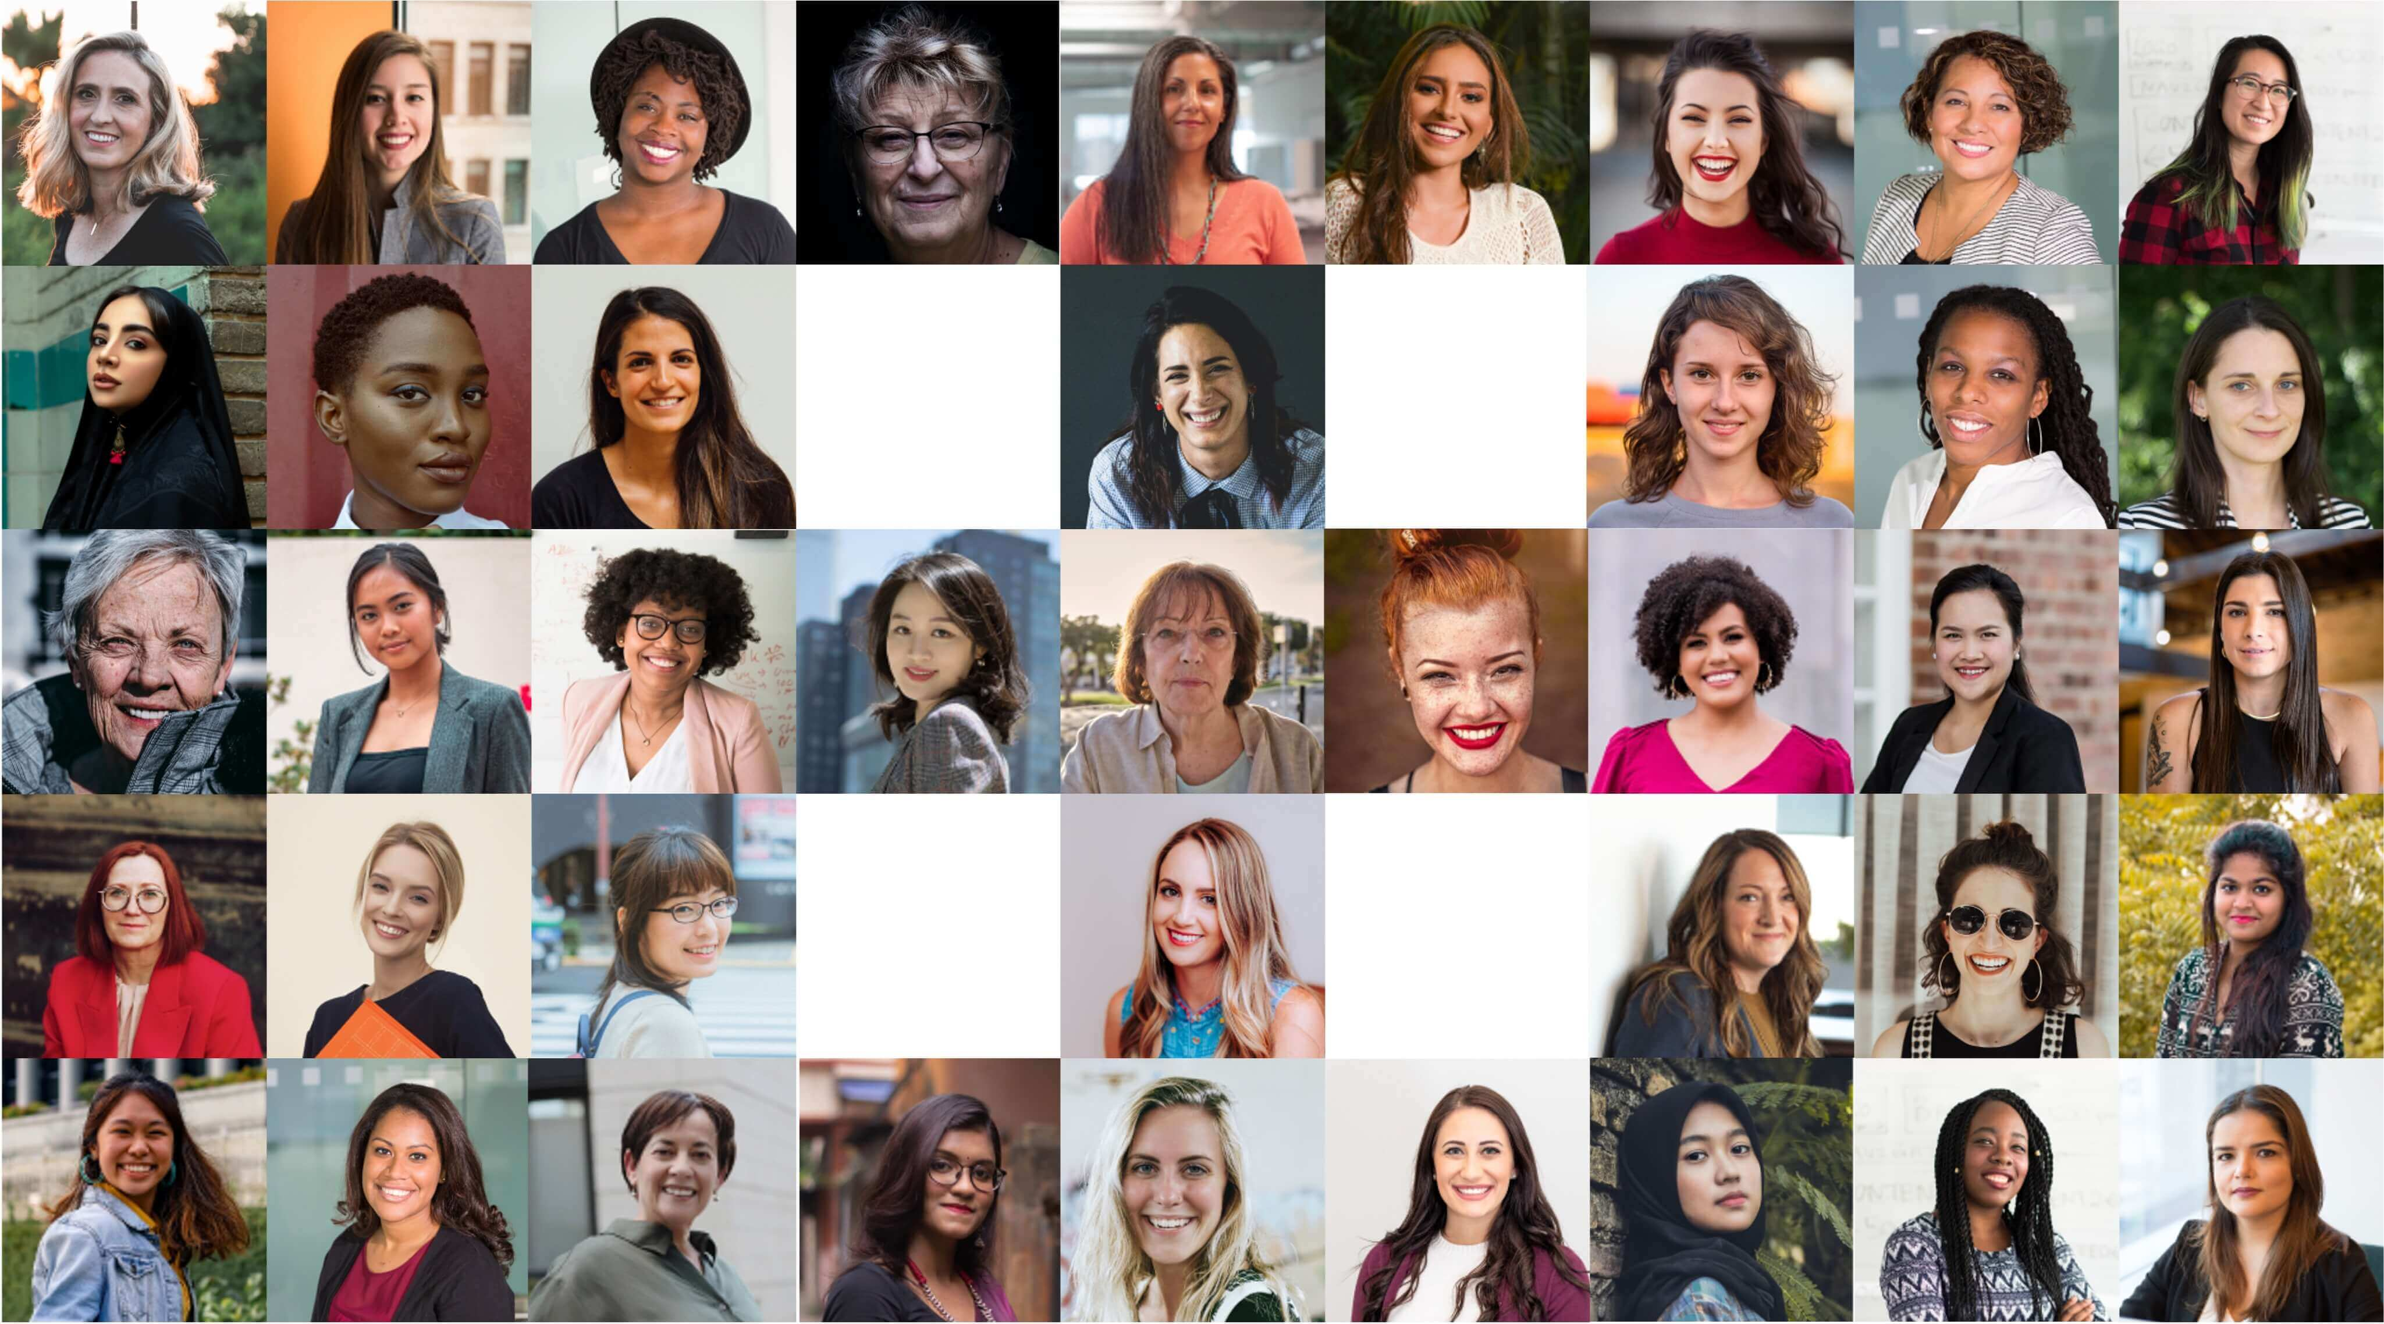

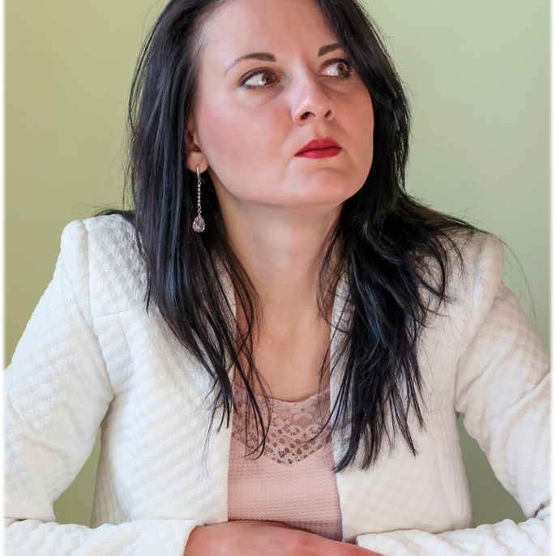
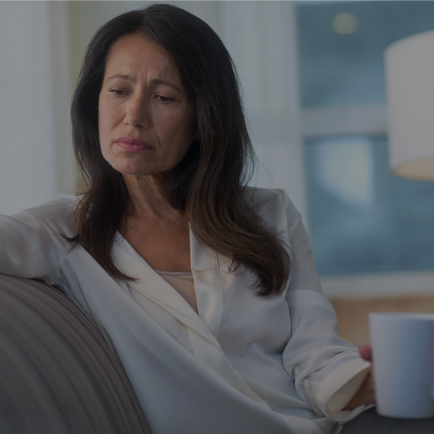
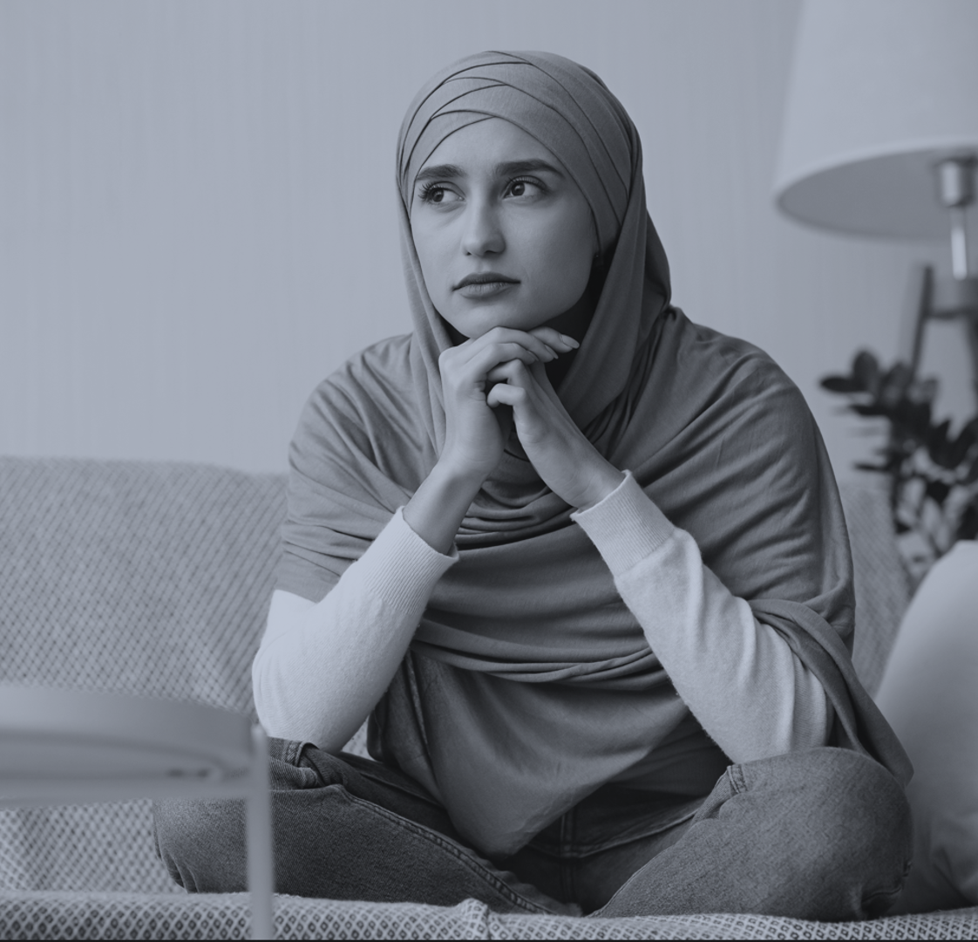
Notes:
Today if you hadn’t guessed it, we are here to talk about women’s health – because let’s be honest it is not talked about in enough rooms in this country.
But it is time to be talking about it, because whilst women live longer lives than men, we live in much worse health than men.
You’ve just heard 4 stories from 4 brave women making their way through various challenges, These are just 4 stories.
But they represent so many more. Women of all ages, races, us, our friends, our relatives, our colleagues, are living with it. We are putting up. We are pushing through. We are getting on with it, because we see no other way.
Did you know that:
Women are half as likely as men to receive painkillers after surgery.
Women are twice as likely as men to experience adverse events from drugs.
40% of women need 10 or more GP appointments before being referred to a specialist.
Women are 50% more likely to receive a wrong initial diagnosis when having a heart attack.
Those initially misdiagnosed have a 70% higher risk of dying.
Women get UTIs up to 30 times more often than men do
One in 10 women is estimated to have endometriosis – it takes on average 7.5 years to get diagnosed, no one understands the cause and there is no cure.
Women in the UK with problematic symptoms of menopause at the age of 50 were 43% more likely to have left their jobs 5 years later.
Black women are still 4x more likely than white women to die in pregnancy or childbirth in the UK, and women from Asian ethnic backgrounds face 2x the risk.
Only 17% of women feel they have enough information on menstrual wellbeing.
Female life expectancy has been improving more slowly than male life expectancy since the 1980s.

Slide 7
It’s time to stop living with it
Notes:
It’s time for this to change, and that starts here today.

Slide 8

OUR MISSION
Our mission is to fill the void of data to enable better outcomes for women
Notes:
natalie

Slide 9
What do we face?
Lack of information
Lack of representation
Lack of funding and research
Notes:
You’ve heard just a snippet of a few stories, and just some of the many shocking statistics which exist. There is documented gender inequality in healthcare. Modern medicine was developed with male physiology as the default.
The predisposition to the male body type has long been reflected in medical training, diagnoses, and therapeutic development, which has influenced how physicians and scientists have come to understand how our bodies work. As a result, men and women historically have very different health outcomes, because we do not have the information.
Half the world’s population are women, we account for the vast majority of consumer purchasing decisions in the Healthcare industry, and yet we are not represented equally in clinical trials even in diseases which affect men and women equally. We do not have the information to be able to advocate for ourselves. Even for conditions which affect us equally, it takes us much longer than men to get a diagnosis, 2.5 years for cancer, 4 years for diabetes, 6 years for girls vs. boys for ADHD.
There is a disappointing lack of funding and research into areas which affect women or disproportionately affect women. Endometriosis is said to be as painful as a heart attack, women with endometriosis face that pain on a regular basis not once or twice in a lifetime like a heart attack, and yet we have no idea why it happens. In comparison there has been a huge amount of research and funding poured into understanding the risk factors for heart attacks. And those studies do not include enough women, so men have better outcomes after a heart attack – there’s a lack of representation.
If I take the issue of chronic pain, 70% of the people it impacts are women. And yet, 80% of pain studies are conducted on male mice or human men.
And according to McKinsey, approximately 1% of healthcare research and innovation is invested in female-specific conditions beyond oncology. There is a lack of funding and research.
At the heart of it all, ultimately we are missing the data

Slide 10
Introducing the ‘shocking stats’ quiz
Notes:
Harriet

Slide 11
Q1. On average, how long does it take a woman to receive a diagnosis for endometriosis?
A) 6 months B) 2 years C) 8 Years
Notes:
Endometriosis is the second most common gynaecological condition in the UK. Endometriosis affects 1.5 million women and those assigned female at birth, a similar number of those affected by diabetes. On average it takes 8 years from onset of symptoms to get a diagnosis.

Slide 12
Q2. What percentage of women with autism are misdiagnosed in the UK?
A) 10% B) 50% C) 80%
Notes:
Nearly 80% of women with autism are misdiagnosed – often with conditions such as borderline personality disorder, eating disorders, bipolar disorder and anxiety

Slide 13
Q3. Black women are ‘X times’ more likely to die during pregnancy and childbirth than white women in the UK?
A) 4 times B) 3 times C) 2 times
Notes:
The latest report identifies pre-existing conditions as being risk factors for poor maternal outcomes, along with socioeconomic factors and attitudes that affect the quality of care women receive, which include ignorance, bias, microaggressions and racism.

Slide 14
Q4. Women in the UK with at least one problematic symptom from the menopause at the age of 50, are X% more likely to have left their jobs five years later?
A)15% B) 32% C) 43%
Notes:
Menopause and the workplace / First report of session 2022-2023
UK parliament
Professor Brewis told the Committee about recent research showed that women who reported at least one problematic menopausal symptom at the age of 50 were 43% more likely to have left their jobs by the age of 55 and 23% more likely to have reduced their hours.

Slide 15
Q5. What percentage of women are still more likely to be misdiagnosed following a heart attack?
A) 20% B) 35% C)50%
Notes:
Both women and men who have heart attack often have chest pain, however in addition to chest pain, women are more likely to have these symptoms: Pain in the shoulder, back or arm and shortness of breath.
Women experience pain in the jaw, neck, back, arm or shoulder, Feeling nauseous, light head or unusually tired.
Women are much more likely to get less common symptoms such as indigestion, shortness of breath, and back pain, sometimes even in the absence of obvious chest discomfort.

Slide 16
Q6. What percentage of women feel they have enough information on menstrual wellbeing?
A) 12% B) 17% C) 25%
Notes:
Less than 1 in 5 have enough information on menstrual wellbeing.

Slide 17
Q7. What percentage of women feel they have enough information on gynaecological cancers?
A) 14% B) 27% C) 34%
Notes:
Less than 1 in 7 have enough information on gynecological cancers.

Slide 18
Q8. What percentage of women felt they were not listened to by healthcare professionals?
A) 84% B) 70% C) 50%
Notes:
The recent Women's Health Strategy for England reported that more than 4 in 5 (84%) women responding to their survey had at times felt that their healthcare professionals were not listening to them.

Slide 19

How do we give women the autonomy, control and respect they deserve?
Notes:
So I have spread a lot of doom and gloom so far, but how do we move forwards and take steps to redress this balance? How do we give women the autonomy, control and respect they deserve? This topic is huge! How do we begin to solve this problem?

Slide 20
It starts with two things
Education
Data
Notes:
Well it really starts with two things.
Education and Data
Good data can inform good research and create the impetus for good policies, it can provide the evidence to drive the advocacy to make change happen.
I represent Women in Data, and we are on a mission to try and use our data skills to redress this balance, to make the policy makers and medical leaders listen, to work with the right professionals to make a change. Before we got started, we wanted to first hear from people all over the country about what their experiences are and what they wanted to see change. So we have been running workshops around the country with businesses, medical professionals and community groups to hear what you want to see changed.

Slide 21

Pre-cancerous cervical disease in women reduced by up to 71%.

Slide 22
10% reduction in breast cancer deaths.
Notes:
Thanks to increased screening, breast cancer is now being detected earlier. 73% of women over 50 now had a mammogram in last 2 years.
Women are able to undergo testing for known breast cancer-causing genes, and there are medical options available to those that test positive.

Slide 23
What have we heard?
Better, more personalised information
Knowledge of the symptoms of conditions
The ability to advocate
The information to take control
Notes:
And you’ve told us that we need:
Better, more personalised information. We are not all built the same – we do not all experience fertility in the same way, periods in the same way, menopause in the same way. We need better information and it needs to be more personalised to our circumstances.
We need to understand the symptoms of conditions so that we can take action ourselves, we can spot what is happening and seek help and most importantly so that we have the ability to advocate for ourselves, for our loved ones. If we do not have this information, if we do not know what we are looking for, we simply cannot navigate our way through the support we need. It’s about having the information to take control of our own lives, to be able to make diet changes, to be able to organise our lives by recognising that hormones do affect us on a daily basis and we will not feel the same every single day as a result. But actually if we could understand that better, we could organise our lives and work to play to our strengths at any given time.

Slide 24
What have we heard?
An understanding of how conditions relate to one another
Improved education of clinicians
Research into the root cause of conditions
Benchmarks
Notes:
You’ve told us that you want a better understanding of how conditions relate to one another, we are not a homogenous blob, some of us will have an underactive thyroid and endometriosis, how do these different things connect with one another? if I have diabetes how does this relate to other things?
We want clinicians to have improved education. There’s years and years of training people based on the male physiology, there’s so much that clinicians are not equipped with the knowledge and information about to help us navigate effectively through this journey. They need training, they need information, they need data.
We want research to happen into the root cause of conditions. We don’t want 1% of healthcare funding on female specific conditions, or even 3% with oncology, we want research to understand why do we get fibroids? Endometriosis? We’ve seen great progress made in cervical cancer by understanding the connection with HPV and by injecting young women and men with a vaccine we have much huge inroads into reducing cervical cancer. We need more of this, we need to look at this for more conditions.
And ultimately, we want benchmarks. To understand what is a painful period, what is a bad pain level? What is normal? Where are you at on the spectrum? How do we know what normal fertility levels are? Why are we not all being told our AMH level earlier in the journey so we have more options available to us? Why does this only come up when you start to have challenges? How do we understand benchmarks that are appropriate based on our own physiology, as a black woman I will probably have different benchmarks from a white woman, so why is that not shared with me? Why am I having to navigate it based on some generic information?

Slide 25
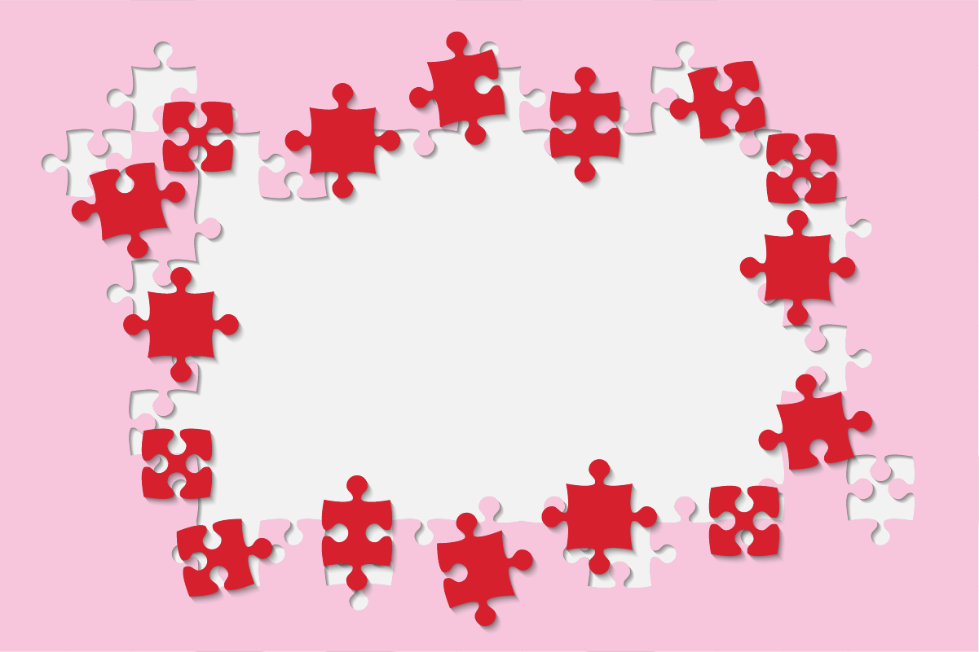
It all starts with data
Notes:
And when you think about all of these things, all of the information we would like to have, the answer is data.

Slide 26

To get there we need…
Good data
Good policies
Good research
Advocacy to make change happen
Notes:
It all starts with good data. We need more data, to be processed and used helpfully, we need to understand what can already be found in the information that is out there and we need to start to direct clinicians, politicians, policy makers, and research companies to be able to focus their efforts where there would be a real difference. Good data leads to good policies, which inform good research.
And as we get started on this journey, where we want to provide that insight to be able to influence policy, to be able to influence the education of clinicians, to be able to influence the clinical trials that take place that hopefully actually have some women on them.
We want to support the community with more education and that needs to go not just to businesses, but to community groups, to schools – start young and support people not to have to navigate so many of the questions in the dark, and to hopefully prevent some of the mental health issues which are caused by the fact that women are navigating these issues without the right information at the right time, and they are left with a lack of confidence, anxiety, real mental health challenges because they haven’t had the support and information that they need.
And the good thing is Women in Data and many of you in this room know about data, so we want to start to understand the data, we want to help to educate all of us with that data, and we want to advocate for change.
We can see where data has been used effectively in the past there have been great results – HPV is just one example, understanding one of the root causes of cervical cancer, tracing back through data and insight, through a vaccine we are now able to prevent thousands of cases of cervical cancer not to mention the reduction in other issues like herpes, use of commercial data helped us to better understand trends in buying patterns which led to better products for those suffering from incontinence - was seen that women were buying sanitary products beyond menopause age, and by understanding the reason for this more appropriate products could be manufactured.

Slide 27
What do you wish you knew?

Slide 28
A format for asking good questions…
If I only knew
[a measurable piece of information]
Then I would
[take an action]
So that I could
[attain a strategic objective]
Notes:
It all starts with good data. We need more data, to be processed and used helpfully, we need to understand what can already be found in the information that is out there and we need to start to direct clinicians, politicians, policy makers, and research companies to be able to focus their efforts where there would be a real difference. Good data leads to good policies, which inform good research.
And as we get started on this journey, where we want to provide that insight to be able to influence policy, to be able to influence the education of clinicians, to be able to influence the clinical trials that take place that hopefully actually have some women on them.
We want to support the community with more education and that needs to go not just to businesses, but to community groups, to schools – start young and support people not to have to navigate so many of the questions in the dark, and to hopefully prevent some of the mental health issues which are caused by the fact that women are navigating these issues without the right information at the right time, and they are left with a lack of confidence, anxiety, real mental health challenges because they haven’t had the support and information that they need.
And the good thing is Women in Data and many of you in this room know about data, so we want to start to understand the data, we want to help to educate all of us with that data, and we want to advocate for change.
We can see where data has been used effectively in the past there have been great results – HPV is just one example, understanding one of the root causes of cervical cancer, tracing back through data and insight, through a vaccine we are now able to prevent thousands of cases of cervical cancer not to mention the reduction in other issues like herpes, use of commercial data helped us to better understand trends in buying patterns which led to better products for those suffering from incontinence - was seen that women were buying sanitary products beyond menopause age, and by understanding the reason for this more appropriate products could be manufactured.

Slide 29
A format for asking good questions…
If I only knew
Which is the right HRT treatment for me
Then I would
Ensure my prescription is correct
So that I could
Perform more consistently at work
Notes:
It all starts with good data. We need more data, to be processed and used helpfully, we need to understand what can already be found in the information that is out there and we need to start to direct clinicians, politicians, policy makers, and research companies to be able to focus their efforts where there would be a real difference. Good data leads to good policies, which inform good research.
And as we get started on this journey, where we want to provide that insight to be able to influence policy, to be able to influence the education of clinicians, to be able to influence the clinical trials that take place that hopefully actually have some women on them.
We want to support the community with more education and that needs to go not just to businesses, but to community groups, to schools – start young and support people not to have to navigate so many of the questions in the dark, and to hopefully prevent some of the mental health issues which are caused by the fact that women are navigating these issues without the right information at the right time, and they are left with a lack of confidence, anxiety, real mental health challenges because they haven’t had the support and information that they need.
And the good thing is Women in Data and many of you in this room know about data, so we want to start to understand the data, we want to help to educate all of us with that data, and we want to advocate for change.
We can see where data has been used effectively in the past there have been great results – HPV is just one example, understanding one of the root causes of cervical cancer, tracing back through data and insight, through a vaccine we are now able to prevent thousands of cases of cervical cancer not to mention the reduction in other issues like herpes, use of commercial data helped us to better understand trends in buying patterns which led to better products for those suffering from incontinence - was seen that women were buying sanitary products beyond menopause age, and by understanding the reason for this more appropriate products could be manufactured.

Slide 30
Please note all statements collected from this workshop will remain anonymous and will only be used to support the inequality in women’s health. Thank you!

Slide 31

There’s no end of problems to solve
Notes:
So, there’s no end of problems to solve, I’m sure you could name 10 issues yourselves, you’ve heard the stories, you’ve heard the stats, there are problems we need to solve for all of these women

Slide 32

But they are finally being recognised
Notes:
But we finally have a women’s health strategy, these problems are finally being recognized in multiple forums.

Slide 33

Data is the answer – and we know data
Notes:
Data is at the heart of the answer to solving these problems, and so many of you in this community know data

Slide 34
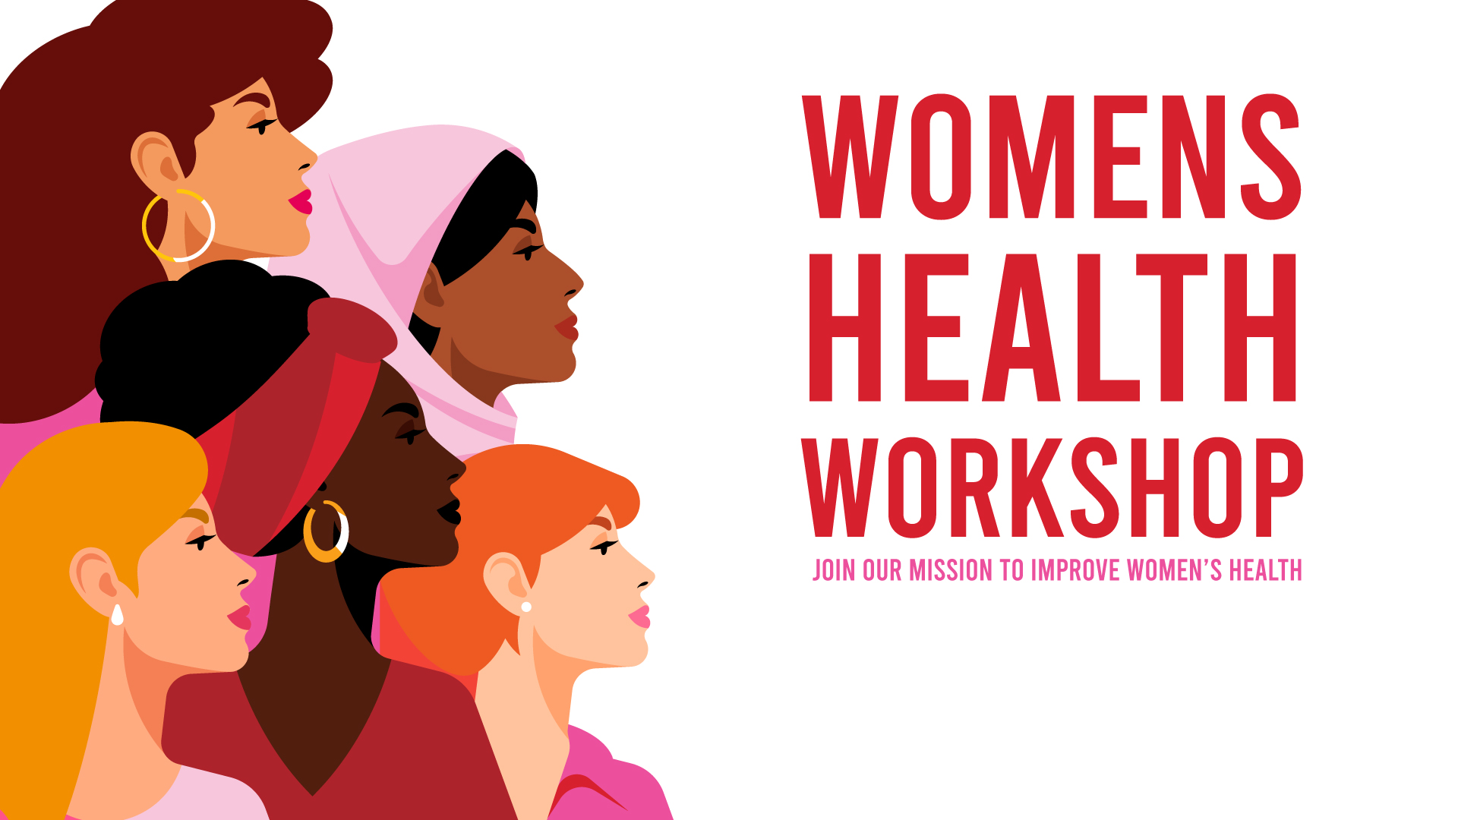
We have momentum – wonderful partners and ambassadors
Notes:
We’ve got momentum. There are wonderful ambassadors and partners like Dame Clare Gerada, like NCR our pilot commercial partner, like Included our inclusion partner, like the wonderful women and men I have to say a huge thank you to who are giving their time to the steerco who have already joined this mission.

Slide 35

But this mission now needs YOU!
Notes:
But now this mission needs you. We cannot do this on our own.

Slide 36

It’s time to stop living with it and get involved
Notes:
It is time to stop living with it and get involved. We need to change this for the next generation of women. We want to make sure that our daughters, our granddaughters, our nieces, our friends do not suffer this in the future, are not shooting in the dark, are not getting by, are not putting up, are not pushing through, but are living long and healthy live, not long lives in a lot of pain.
So we need you to stop living with it and get involved

Slide 37
We have 3 simple asks:
Raise awareness -
run workshops in your organisations, schools or community groups
Volunteer – come and help us crack the data
Donate your data – partner with us to increase the data we can work with to get even better results
womenshealth@womenindata.co.uk
Notes:
We have 3 simple asks.
Help us raise awareness, we have a workshop pack - run them in your organisations or community groups, we are developing a pack for schools which will be ready imminently through the Girls in Data work. So please reach out to Harriet her address is here – we have seen amazing results of the workshops, just getting women talking, supporting one another, sharing things they’ve never shared before in the workplace and opening up the conversation.
2. The second thing is Volunteer - give us your data skills, UX skills, Project Management skills to come and help us crack the data and the fantastic Monica and Emma on the SteerCo will be heading up that work with NCR to really start to mine that data and see the insights we can get in this pilot discovery phase.
3. And finally if we are going to change this, we need scale – we need (safely and securely, and anonymised of course) your data - the more information we can combine, the stronger the insights we will be able to provide to be able to campaign for change, help decision makers to see where the problem is and why they need to help us change this – it’s time to change, it is time to stop living with it.
So please get in touch with Harriet, please do join our mission.
If we put our collective data and tech feet down there’s a chance the next generation of women can thrive not survive. And thank you for listening to us today.

Slide 38
Thank you!

Slide 39
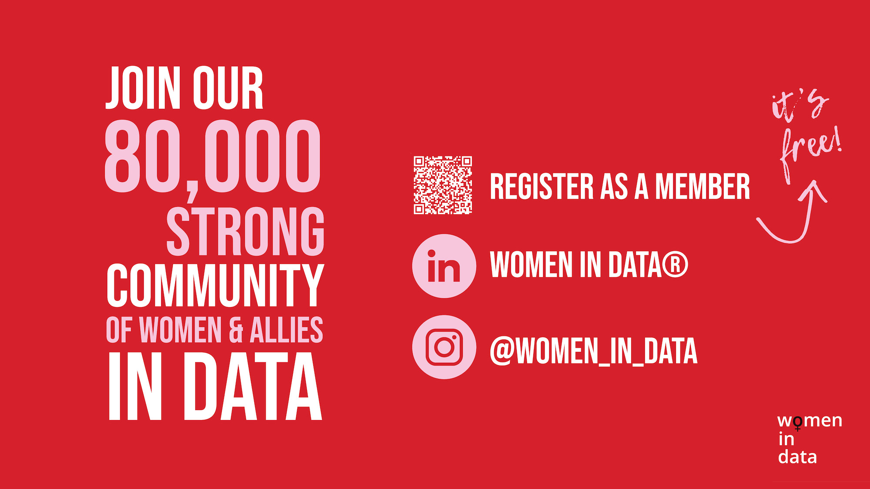
Notes:
Non-editable page to avoid any mistakes

